Slide 1
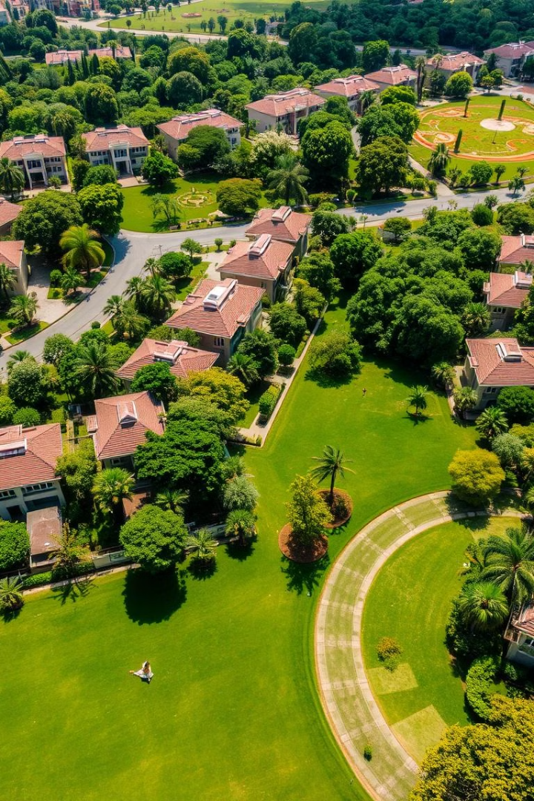
Green City Plots near Gachibowli, Hyderabad
Discover premium plots in a prime location.
Invest in your dream property today.
Experience modern living in a serene environment.
Notes:
1

Slide 2
Prime Location Advantages
Proximity to Gachibowli
Excellent Connectivity
Close to Amenities
Easy access to IT hub and business district.
Well-connected to major highways and roads.
Near schools, hospitals, shopping malls.
Notes:
2

Slide 3
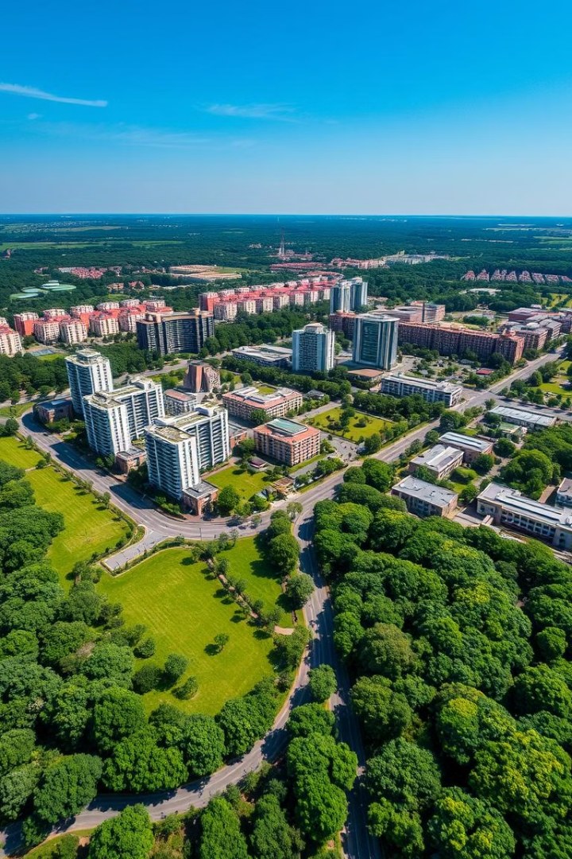



Green City Features
Lush Greenery
24/7 Security
Wide Roads
Abundant green spaces and parks.
Secure gated community with surveillance.
Well-planned infrastructure with wide roads.
Notes:
3

Slide 4
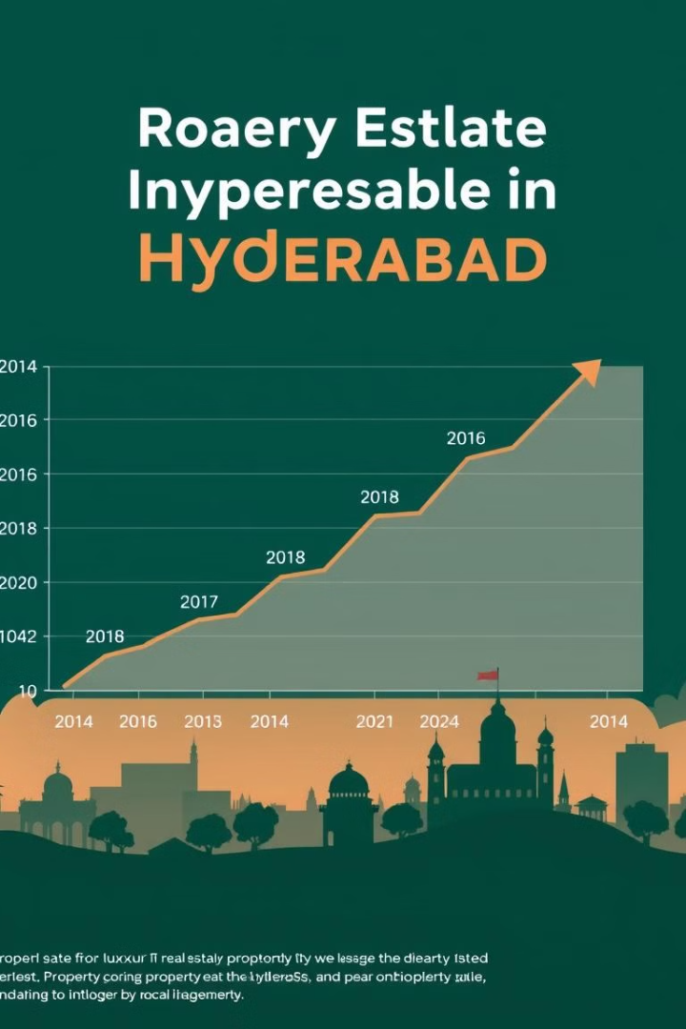

Investment Benefits
1
High Appreciation
2
Strategic Location
Potential for significant property value growth.
Located in a rapidly developing area.
3
Future Development
Planned infrastructure and amenities nearby.
Notes:
4

Slide 5
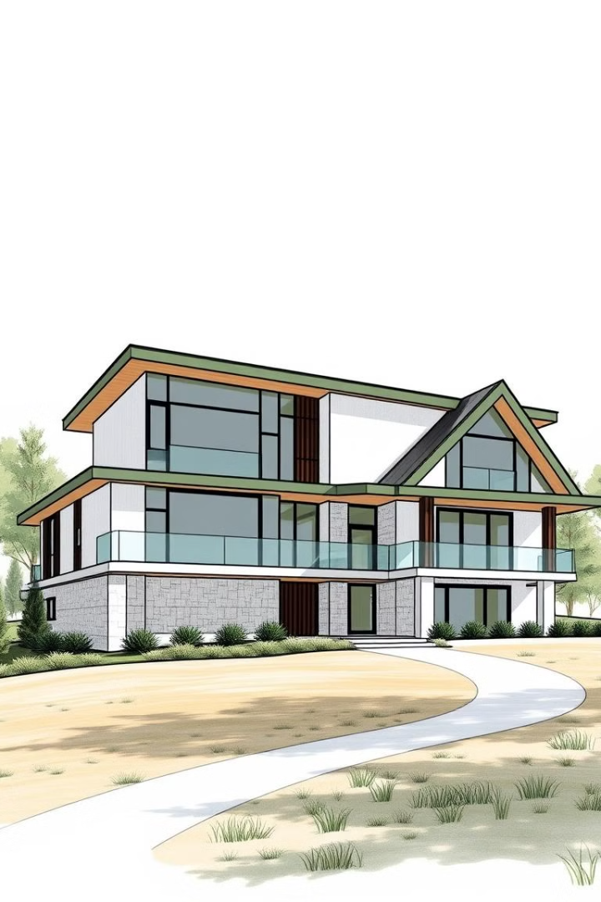
Plot Sizes and Options
Residential Plots
Customization
Various sizes available to suit your needs.
Design and build your dream home.
Flexible Payment Plans
Easy and convenient payment options.
Notes:
5

Slide 6
Why Choose Green City?
Reputation
1
Trusted and reliable developer.
Quality
2
High standards of construction and design.
Customer Satisfaction
3
Dedicated support and service.
Notes:
6

Slide 7

Contact Us Today
Secure your plot in Green City now.
Visit our website for more details.
Call us to schedule a site visit.
Notes:
7

